Slide 1






!
?
Statement Of The Problem
!
!

Slide 2
!
What is Problem Statement?
?
The statement of a problem is a statement of present problem/ issue which needs appropriate actions to improve the condition.
It briefly deliberates the barriers of present issues placed between practical products and process and problematic situations.
!
!

Slide 3
!
Why Statement Of The Problem Is Important In Research?
?
Problem statement is a useful tool of communication.
It is significant to individuals, businesses, and other entities to establish projects emphasised on improvement.
It helps in the decision- making processes of these projects.
!
!

Slide 4
!
When Should You Write A Statement Of The Problem?
?
There are various conditions where you may have to compose the statement of the problem.
It helps you in understanding the problem and help you in finding and executing efficient solutions.
!
!

Slide 5
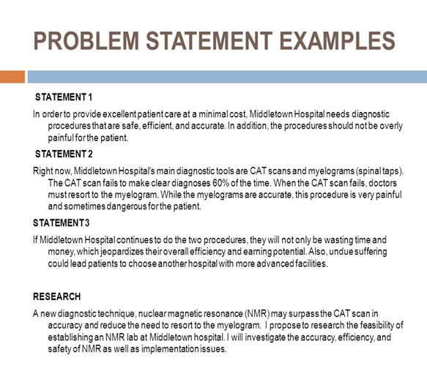
!
Examples
?
!
!

Slide 6
!
How to Write a Statement of the Problem?
?
There are some main essentials that is necessary for you to consider before composing the statement of problem.
It can positively influence your dissertation’s results.
!
!

Slide 7
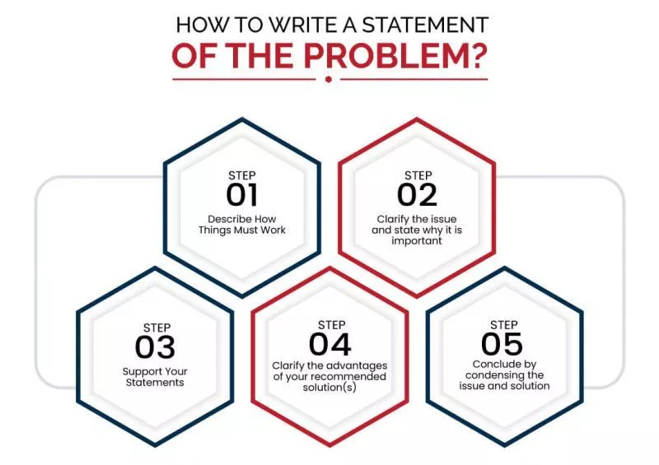
!
?
!
!

Slide 8
!
Propose A Solution
Your dissertation’s problem statement needs to propose solution(s) to the issue.
You need to have a solid understanding on the cause of problem and be ready to recommend real-world methods to understanding and resolving it.
?
!
!

Slide 9

!
?
!
!

Slide 10
!
?
GOOD LUCK
!
!

