Slide 1






!
Primary Data
Versus
Secondary Data
?
!
!

Slide 2
!
What Is Primary Data?
The information that is accumulated directly from first-hand experiences is known as Primary data.
This method is used by authors for obtaining data for a particular kind of research.
This kind of data collection method is also regarded as raw material since it comprises of original data from first source.
Using a primary data collection can be a hectic choice but it assures guaranteed results in most of the cases.
?
!
!

Slide 3
!
Kinds Of Primary Data
Interview (telephone, personal interview, e-mail)
Experiments
Self-administered surveys and questionnaires
Diary entries, letters, and other correspondence
Case studies
?
Field surveillance
Ethnographic research
Action research
Life histories
Eyewitness accounts
Personal narratives, memoirs
!
!

Slide 4
!
Pros & Cons Of Primary Data
Pros of Primary Data | Cons of Primary Data
Improved Accuracy | More Limitations
A Greater Level of Control | Not Always Possible
Up-To-Date Information | Time-Consuming
You Are The Owner Of The Information | More Expensive
?
!
!

Slide 5
!
What Is Secondary Data?
?
The data that have already been collected previously for another purpose but has some significance to research needs of the current research is called secondary data.
Additionally, the information is accumulated by somebody else instead of the author of the study himself. This method is also known as second-hand information.
!
!

Slide 6
!
What Is Secondary Data?
?
Secondary sources are utilised for the first time. Hence, it is called secondary.
Valuable readings and analysis grounded on primary sources are provided by secondary sources.
Secondary sources elucidate primary sources in detail and often make use of them for supporting a particular research or a point of view.
!
!

Slide 7
!
Kinds Of Secondary Data
Journal articles
Works of criticism & interpretation
Biography
Dissertations
Official statistics
Mass media products
Government reports
Google Analytics.
Previous researches
Financial sources Letters
Diaries
Research analysis
Web information
Historical data
Encyclopaedias
Monographs
?
!
!

Slide 8
!
Pros And Cons Of Secondary Data
Pros of Secondary Data | Cons of Primary Data
Anyone Can Collect The Data | More Limitations
Low Cost or Free | Not Always Possible
Ease of Access | Time-Consuming
Time-saving | More Expensive
?
!
!

Slide 9
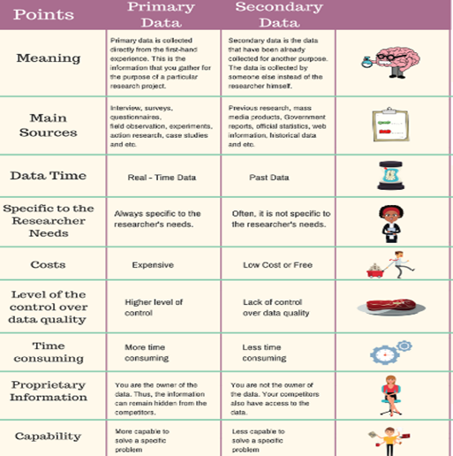
!
Difference Between Primary Data & Secondary Data
?
!
!

Slide 10
!
?
GOOD LUCK
!
!

